Slide 1
STRUCTURE OF CHINA

Slide 2
CORONA VIRUS
Two hospitals in Wuhan, not one.
On lines of Xiaotangshan Hospital, Beijing (SARS).
Huoshenshen by 03 Feb.
1000 beds.
2.7 lakh sq ft.
Leishenshan By 05 Feb. 3.3 lakh sq ft. 1300 beds.
Both only for nCov. Only treat Pneumonia

Slide 3
ATTENDANCE & feedback

Slide 4
WHAT IS LIBERATION? WHAT WAS THE REVOLUTION, EXACTLY?

Slide 5
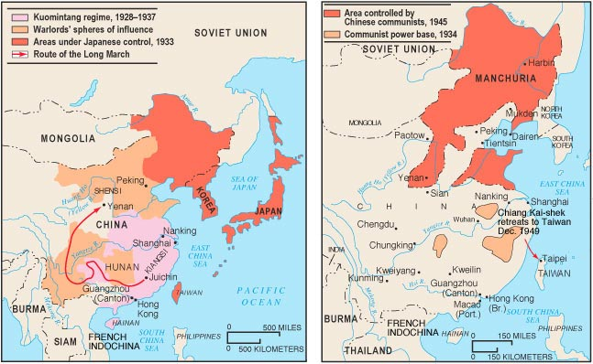

Slide 6
CPC
The Party is like GOD, you cannot see him, yet He is everywhere.
Represents the broad interests of the Majority of the People.
Primary Aim is Continuation of People’s Democratic dictatorship.
Chinese State and the PLA are an Arm of the Party

Slide 7
Lessons from the Soviet Union.
No separation of Powers.
Hide Your Brightness and Bide your Time.
Yes to Economic Freedoms, No to Political Freedoms.
Leadership has become more rigid and conservative.
Central Organization Department and the CCDI.

Slide 8
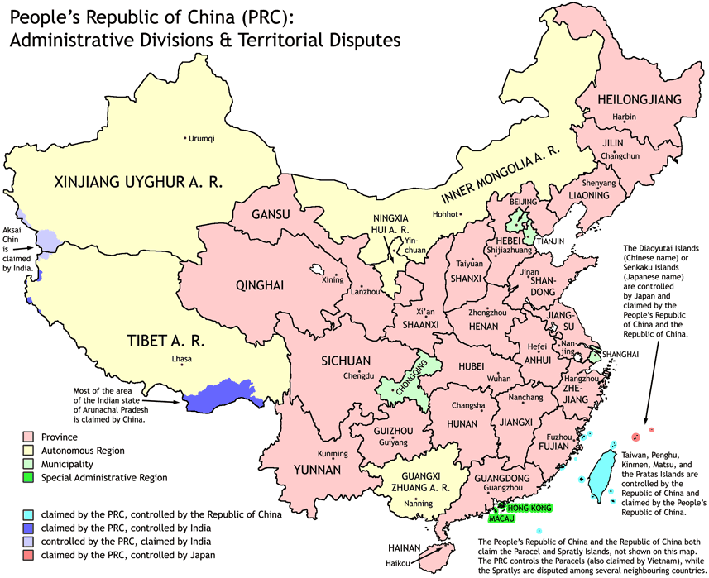
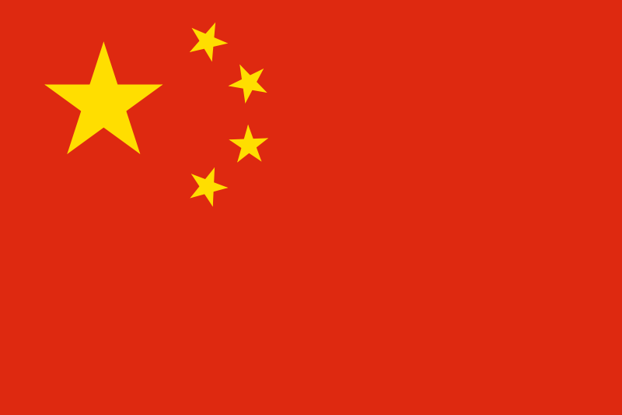
No change in provincial boundaries for the last 400 years (Ming).

Slide 9
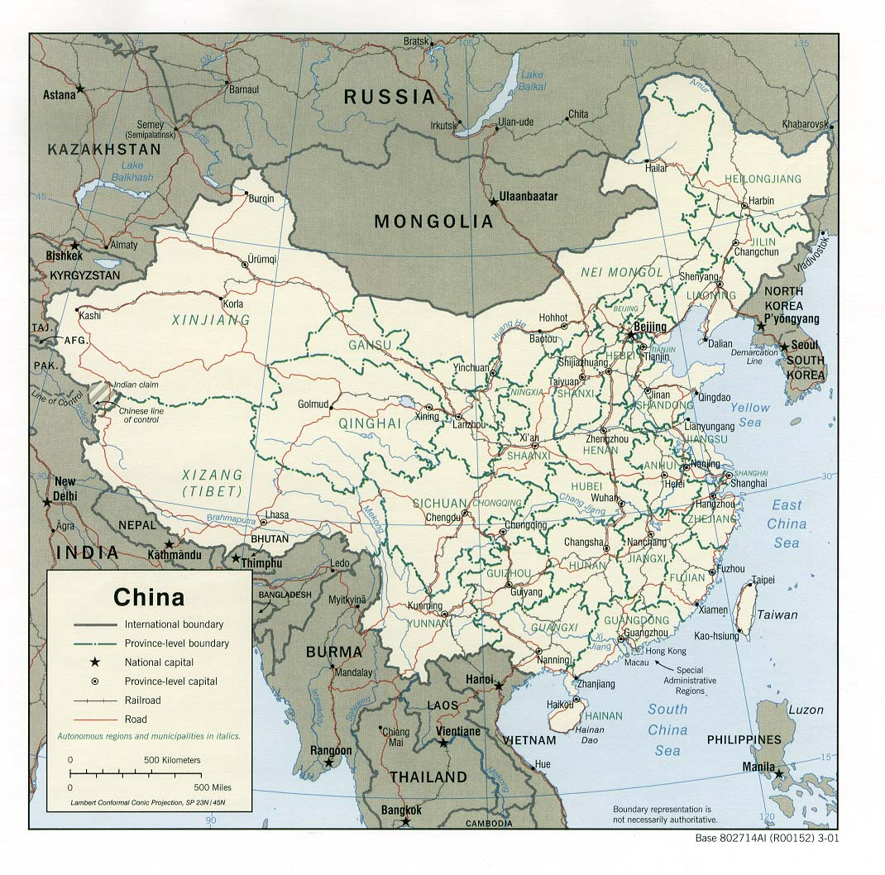
CHINA: AUTONOMOUS REGIONS
NINGXIA
NEIMONGOL
XINJIANG
XIZANG
GUANGXI

Slide 10
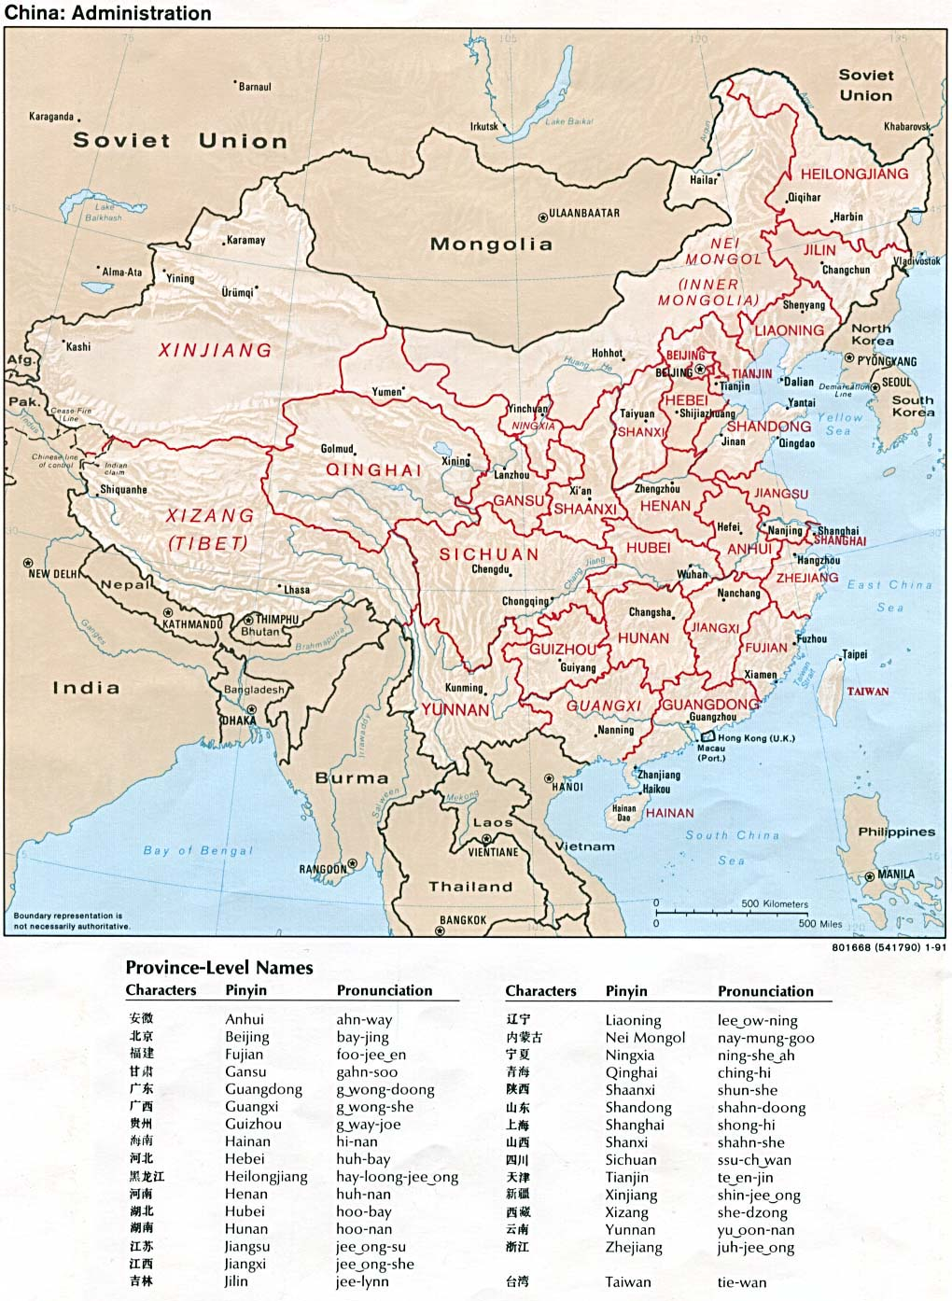
CHINA: CENTRALLY ADMINISTERED MUNICIPALITIES AND SARs
TIANJIN
BEIJING
SHANGHAI
CHONGQING
HONG KONG
MACAU

Slide 11

THE CHINESE ESTABLISHMENT
Three Pillars Of The Chinese Est:
The Communist Party Of China
The State
The Military
The State Encompasses:
The Legislature
The Executive
The Judiciary

Slide 12
POL SYSTEM
Multi-party state with the CCP and eight other smaller pol parties
PRC constitution mandates rule by the CCP
All officials are not members of the CCP
Cross-membership of bodies of the CCP, govt and military – Chinese characteristic
Mirror images at level of apex bodies like the CMC

Slide 13
POL SYSTEM- REPRESENTATION OF THE PEOPLE (contd)
CCP highly centralized – ldrs are usually appointed
No open elections – proportionate incr in the eff of connections (guanxi) and backroom contacts (houmen)
Seats in NPC also for other parties – lip service to democratic rep
Specific wk units like the PLA has reserved seats in the NPC
Open elections with choice of candidate available only at county and below
Party Committees
Large bodies, infrequent mtgs
Domination by Hans
Ratification, pro forma debates on issues

Slide 14
STRUCTURE OF THE CPC
DEMOCRACY IN CHINA.
VOTING SYSTEM, “ONE LEVEL HIGHER”.
IMPACT OF MANDATORY RETIREMENT AGE. ALL SAME AGE GROUP!
NATIONAL CONGRESS OF THE CPC…2280 DELEGATES REPRESENT 89 MILLION PARTY MEMBERS.
SELECTS THE CENTRAL COMMITTEE. ( & THE MEMBERSHIP OF THE CCDI)
SELECTION PROCESS SUPERVISED BY THE CENTRAL ORGANIZATION DEPARTMENT.
ELECTION TO THE POLITBURO.
POLITBURO STANDING COMMITTEE.

Slide 15
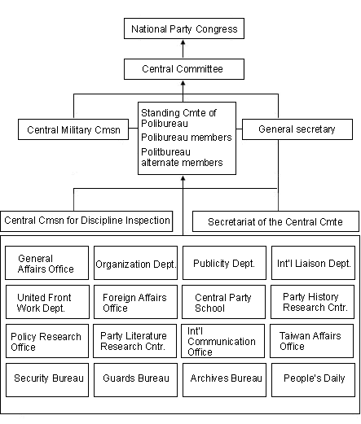

Slide 16
CENTRAL COMMITTEE
202 FULL AND 171 ALTERNATE MEMBERS IN THE CENTRAL COMMITTEE. METHOD, RANKING, QUOTAS.
CONFIRMS THE GENERAL SECRETARY, POLITBURO, PBSC, CMC
OVERSEES POWERFUL NATIONAL LEVEL ORGANIZATIONS.
PROPOGANDA.
ORG.
UNITED FRONT.
INTERNATIONAL LIASION.

Slide 17
POLITBURO AND PBSC
25.
SIMULTANEOUSLY HOLD POWERFUL POSITIONS IN THE STATE.
NO VOTING AT PB. ONLY DISCUSSION.
PB VS CENTRAL SECRETARIAT (DIRECTLY UNDER THE GEN SECRETARY).
PBSC -7.
STANDARD MEMBERS:
GEN SECY, PREMIER, CHAIRMAN OF THE NPC, CPPCC CHAIRMAN, CCDI.
OTHERS.

Slide 18
中国共产党中央政治局常务委员会
Gen Secy – Xi Jin ping
Premier – Li Keqiang.
Chairman of Standing Committee of the National Peoples Congress – Li Zhan shu.
Chaiman of the CPPCC - Wang Yang.
Secy of the Party Sectt- Wang Huning.
Secy CCDI - Zhao Leji.
Vice Premier of the State Council- Han Zheng.

Slide 19
SCHEDULE
NATIONAL PARTY CONGRESS – 5 YEARLY (SINCE 1977), 19TH.
POLITBURO MEETINGS- ONCE MONTHLY.
PLENUMS OF THE CENTRAL COMMITTEE.
BEIDAIHE. ESPECIALLY THE ONE BEFORE THE PARTY CONGRESS.

Slide 20
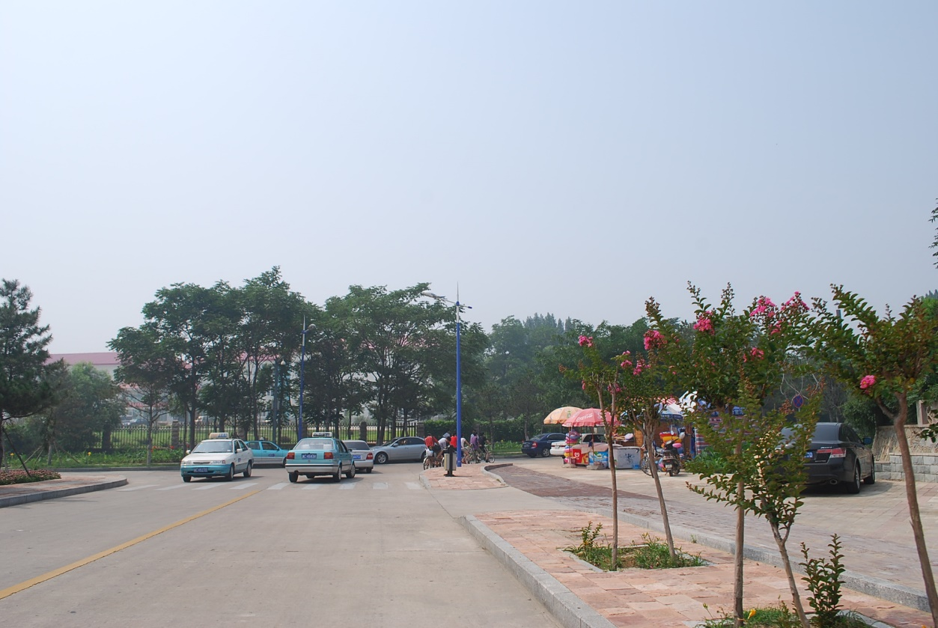
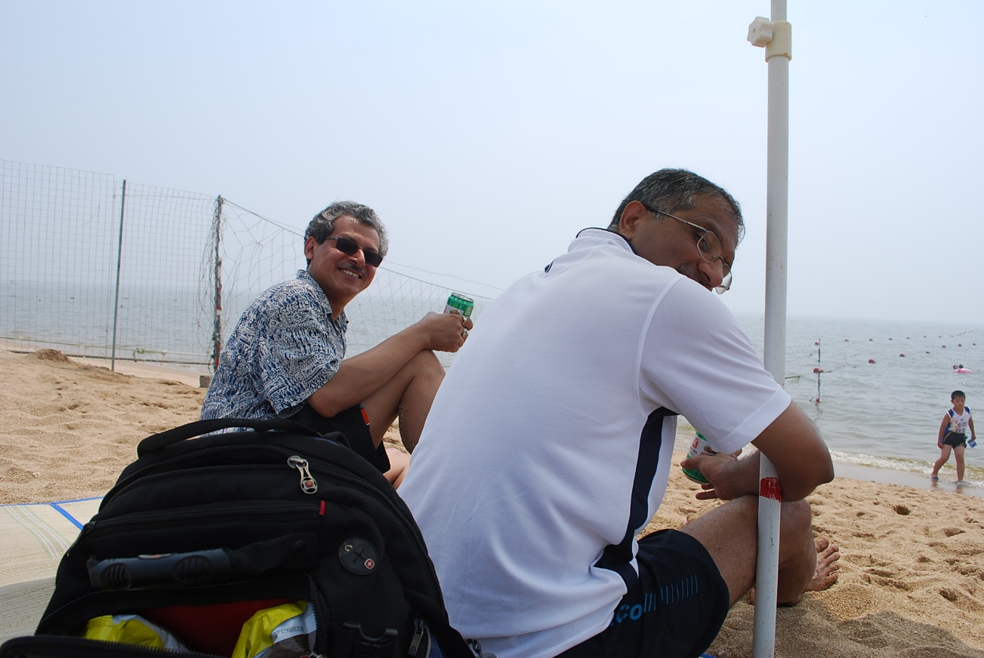
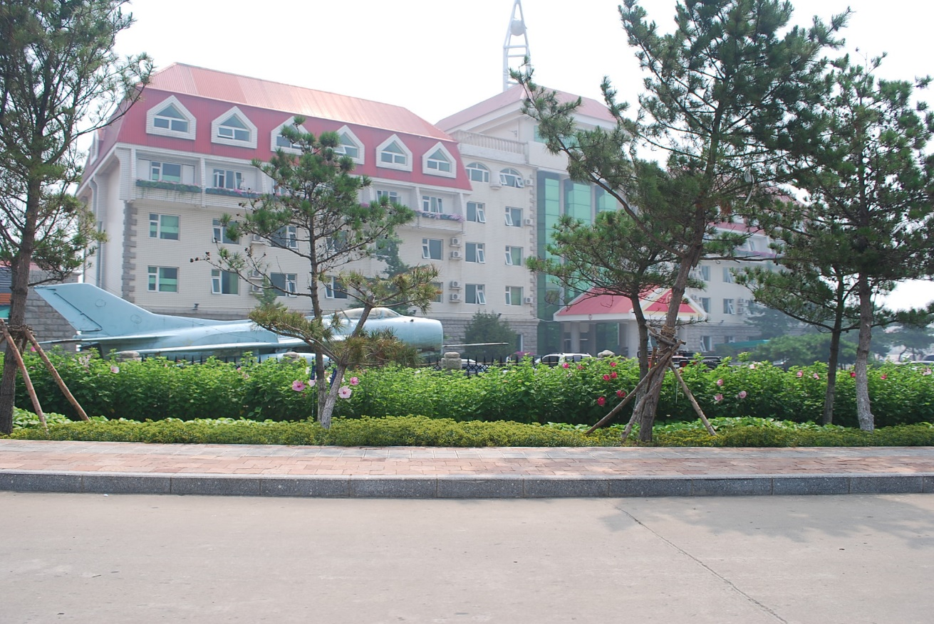
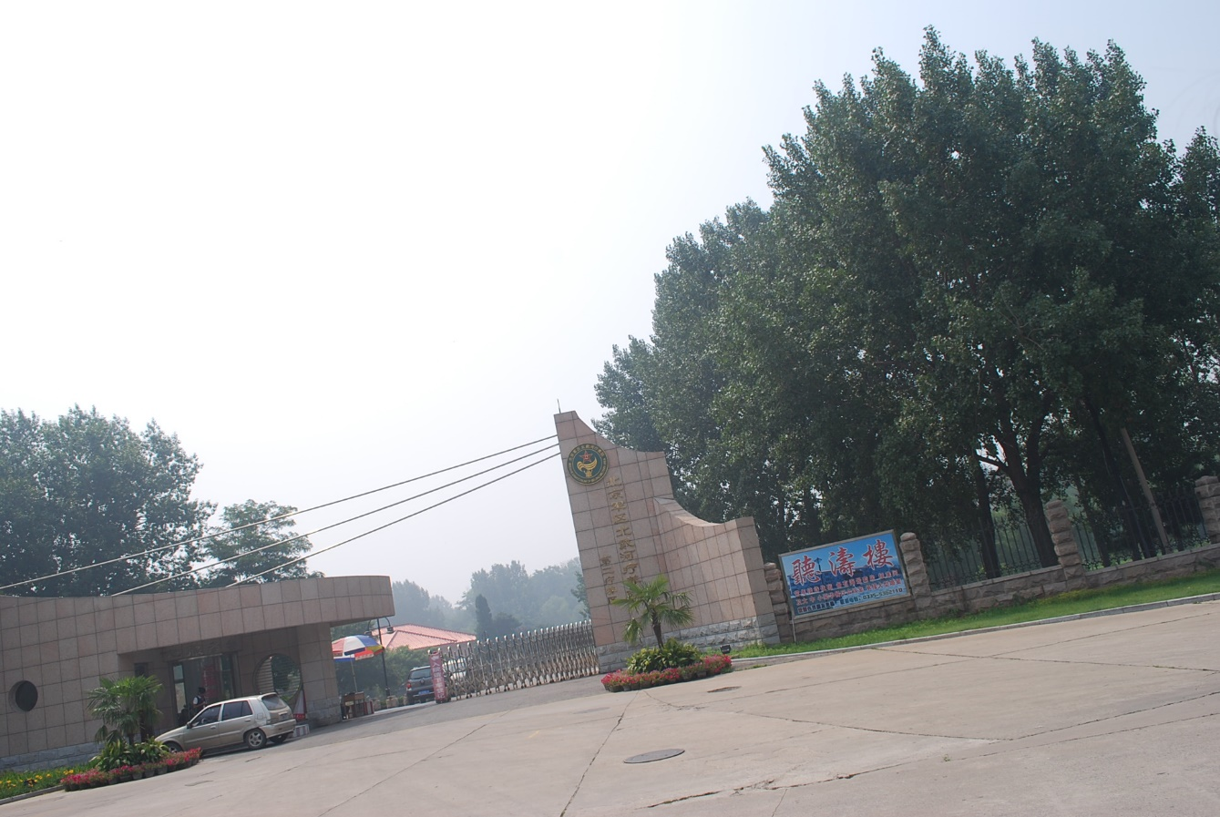

Slide 21
4th Plenum of the 19th Party Congress
28 – 31 Oct 2019.
Held after 600 days. (longest gap in Post Mao Era).
Plenum approved Politburo policies.
Most Imp to consolidate the “ party line”.
Held at Jingxi Hotel in West Beijing.

Slide 22
Imp Outcomes
Further accredited Xi’s ideological positions and doctrine of “Socialism with Chinese characteristics in the new era”, as well as endorsed his position as the core CPC leader.
uphold law-based governance (依法治国 yi fa zhi guo).
Re emphasised the long-term objectives of completing the national rejuvenation and building of a moderately prosperous society.
solving problems related to the “two-no worries and the three guarantees” but also curbing local corruption in order to fulfill the 2020 poverty alleviation goals.
President Xi stressed that China would not follow the “Western path of economic liberalization” but construct its own system of governance “adapted to domestic conditions” which would be underpinned by the dominant role of the state in the economy.

Slide 23
Agenda
Focus on “Upholding and improving the system of Socialism with Chinese Characteristics and the modernization of China’s System and capacity for Governance”.
Submitted for review. The phrase first appeared at the Third Plenum of the 18th PC.
Larger plan to be “basically” complete by 2035 and fully realized by 2049.
Promotions?? New Faces? Successor?

Slide 24
GOOD GOVERNANCE
Means strengthening party’s control over state organs to steer towards “National Rejuvenation”.
Govt Reorg of 2018 approved.
To ensure no confusion.. Xi’s Quotes regularly published

Slide 25
Key Element is Focus is on “Xi Jinping Thought”.
“ Fortress Mentality” to redirect criticism.
May add to Trade and other tensions!

Slide 26
ORG OF GOVT
NPC (National Peoples Congress)
PRESIDENT
STANDING COMMITTEE OF THE NPC
PREMIER
CMC
STATE
COUNCIL
SUPREME
PEOPLE’S
COURT
SUPREME
PEOPLE’S
PROCURATORATE

Slide 27
ORG OF GOVT(contd)
NPC(Quanguo Renmin Daibiao Dahui)
Unicameral legislature
2985 deputies, all “elected” by lower party committees, annual mtgs. No Pay… Can hold Other Posts.
Five-year term, exec body standing committee of the NPC
Funcs
Legislation – fmn and approval of laws
Amdts to laws
Nomination
Elects president and vice president, president of the supreme court
Approves nomination of State Council, CMC
Basically ratifies decision of State Council.

Slide 28
ORG OF GOVT(contd)
State Council
Chief federal exec organ
Adm cont at all levels ex by the Council
Responsible to translate Party decisions into govt / public policy.
25 Ministries. 38 Centrally Administered Orgs reporting directly. MND.
Meets once every six months.
Standing Committee meets every week. 10.

Slide 29
ADMINSTRATIVE DIVISONS (4 LEVELS)
Historical reasons
Provinces, Autonomous Regions, Centrally Administered Municipalities And Special Administrative Regions.
Prefectures
Counties
Township
Basic Level autonomies
33 provincial-level regions, 334 prefecture-level divisions, 2,862 county-level divisions, 41,034 township-level administrations, and 704,382 basic level autonomies.

Slide 30
GOVERNERS.
MAYORS.

Slide 31
CONCEPT OF LEADING SMALL GROUPS 领导小组. (APPROX DOUBLING)
PARTY – 26.
STATE COUNCIL – 57.

Slide 32
PLA
(Jie Fang jun)

Slide 33
ABOUT PLA
TO UNDERSTAND THE PLA, YOU HAVE TO FIRST UNDERSTAND AND STUDY THE PARTY AND THE POLITICS.
CENTRAL COMMITTEE MEMBERSHIP IS FIRST STEP.
POLITICS IS THE SOUL OF THE PLA. “RED VS EXPERT” IS AN IRRELEVANT DEBATE AS MEMBERSHIP IN THE PARTY HAS GOT NOTHING TO DO WITH IDEOLOGY
IT IS ARM OF THE PARTY AND NOT THE STATE.

Slide 34
AN INDEPENDENT ENTITY, OUTSIDE THE STATE.
THE OATH OF LOYALTY IS TO THE PARTY & NOT CHINA.
ALL ARMED ENTITIES ARE UNDER THE PLA.
OWN LAWS, OWN COURTS. NO MEDIA, NO AUDIT, NOTHING.
ONLY ANSWERABLE TO THE CMC.
EG. GEN ARMT DEPT
HUGE CLOUT, NO ONE KNOWS THE TRUE WEALTH AND HOLDINGS OF THE PLA.
RUNS ITS OWN FOREIGN AFFAIRS.

Slide 35
CONSCRIPT BASED SYSTEM…. ONLY 5% ACTUALLY GET CONSCRIPTED.
NCOs. Maybe 900,000.
MIL TRG IN COLLEGES.
FOCUS ON INFORMATIONISATION AND SCIENTIFIC APPROACH TO DEVELOPMENT.

Slide 36
PLA MODERNISATION
DOWNSIZING. GP ARMY- BDE- BN STRUCTURE.
FOCUS ON PLAN AND PLAAF.
OUTSOURCING.
NCO CADRE
FOCUS ON IT, DIGITIZATION.
INFRASTRUCTURE DEVELOPMENT. PLA NEEDS IN INFRA BUILDING.
TRG FOCUS.
PAY AND PERKS.
RETAINS THE STICK.

Slide 37
ABILITY TO MOBILIZE
300,000 CAS IN THE KOREAN WAR.
MORE THAN 100000 IN VIETNAM WAR.
NO POINT CALCULATING ROAD CAPACITY / AVAILABILITY OF ROAD SPACE/ LOGISTICS TERMS OF REFERENCE , EXCEPT MAYBE IN LAST FEW KMS.
EX MISSION ACTION

Slide 38
HOW IS THE PLA ORGANISED
THEATRE COMMANDS (5).
RESP AS PER PROVINCES. BASICALLY INTERNAL.
EXTERNAL BOUNDARIES AS RELEVANT TO THOSE PROVINCES ALSO INCL.
PROVINCIAL MIL AREA COMDS AND 2-3 CCs.
ONE AB CC AND ONE AMPH CC.
MARINES UNDER PLAN.
PLAN AND PLAAF UNDER MRs.

Slide 39
Armament Industry

Slide 40
TIBET
SUPERB INFRASTRUCTURE.
QTR, HIGHWAYS.
AIR, AS ALSO IN YUNNAN.
PARA DROPS, FOCUS ON SPECIAL FORCES, DIVERS TRG, HOVERCRAFT, FOO OF SEC ARTY IN Exs.
MOB OF J11 TO TAR, LATEST SAMs, UAVs.
TRANS REGIONAL TASKING.

Slide 41
IMP OF SLOGANS, SYMBOLISM https://www.google.com/maps/place/National+Stadium/@39.9930555,116.1163425,10z/data=!4m5!3m4!1s0x35f054c407008c87:0xee35c9d7f5e387b6!8m2!3d39.9929431!4d116.3965112

Slide 42
HOW TO READ PARTY PUBLICATIONS

Slide 43
SYMBOLISM
Rice Rabbit 米兔.
Little Bottles.

Slide 44
CAN THE PRESENT SYSTEM CONTINUE???
CORRUPTION?

Slide 45
A Corrupt Officials Last Words before His Execution
[ Wen Qiang (文强), former Deputy Director and Deputy Party Secretary of the Chongqing Police Department, was sentenced to death in 2010. He was charged with the crimes of accepting bribes, protecting and conniving with mafia-like organizations, possessing a huge number of assets whose sources could not be explained, and rape.]
Wen Qiang started as a local policeman in Ba County, Chongqing and gradually moved up the ranks. Before he was taken down, he had solved several big cases and was highly regarded as a top police chief in China.

Slide 46
Bo Xilai, then head of Chongqing took Wen Qiang down. He later started a high profile campaign to “strike the black” (attack the mafia in Chongqing) to build his personal fame so that he could eventually seize the top leadership position in China from Xi Jinping. Critics alleged that many victims of his campaign were businessmen who were falsely accused so that Bo could take over their properties.
An article with what was said to be Wen Qiang’s statement before his execution spread widely over the Internet. He admitted that he had accepted bribes and had improper sexual relations with many women, but he claimed that corruption is a nationwide, systemic problem. Not only would any official in his position have done the same thing, but the officials criticizing him were also corrupt.

Slide 47
Though Wen was executed on July 7, 2010, his last words can serve as a good reference in the current anti-corruption campaign in China. It sheds lights on the breadth and scale of the official corruption problem in China.
The translation of his last words follows:] [1]
“I have thought it over clearly – I have participated in and known too many things. If I don’t die, many people won’t be able to sleep well. If I am not killed, they will face too many risks. My death brings more benefits to them. I could drag them down so we would die together, but (if I did so), my wife and child would be in danger. People said that I am a demon, but as a husband and as a father, I am not that venomous to my family. Many people wish me to die immediately. I will die. Before I die and leave (this world) though, I want to say a few words.”
“Many people said that I accepted a lot of money and slept with many women. I don’t deny those charges. What I want to say is that this is my fault and this is also NOT my fault. Of course, I still take responsibility. (But the fact is that) whoever was put at my position would also take in that much money and sleep with that many women, if not more. If I don’t sleep with those female students, other (officials) will. I was charged with rape, but was what I did really rape? All I did was follow the rules of the game to do something that everyone in that circle did.”

Slide 48
3. “Everyone knows this: If an official does not accept bribes and does not have a mistress, who would dare to trust him and promote him? It doesn’t matter how good a job he does. Besides, there are several hundred thousand, if not several million, officials who behave the same way I did. Will the problem be solved by singling me out and executing me?”
“I also want to explain the reason that I started as a local policeman in Ba County and moved all the way up to be the Deputy Director of the Chongqing Police Department. It was not because of corruption. In fact, I am way better than those police officials who collect their pay but do nothing. My work (my achievements) came first; my accepting bribes was always second.”
“I, at most, was just a deputy director of the police department. (The charge said that) I could do anything at will in Chongqing. Who gave me that power? What did the higher official above me do (to stop me)? Who were those officials who knew what I did but pretended not to know?”

Slide 49
“Since (they) decided not to let me live, I will make the following point: The money I accepted was way more than what was found. Where was the rest of the money? I did accept money from people and in return, I helped them out. Sometimes I did it by myself, and sometimes I had to ask others to help. Can you ask others to do that without giving them money? Those officials who took money from me and those who gave me money are (denouncing corruption and) using me as a negative example. I don’t want to deny that the evidence is valid. However if you go their homes and have a look, you will observe that the money and artworks in my home are very shabby compared to what they have in theirs.”

Slide 50
. “I have read many books. In the past, people in Beijing applauded when a bad person was beheaded, but isn’t everything still the same after a beheading? Has China changed from several hundred years ago? I don’t see much change. Executing me was only to keep my mouth shut. Could that fix the root cause of corruption? There were many people in Chongqing who lit firecrackers (to celebrate my sentence) yesterday. Weren’t there firecrackers when I closed the case of Zhang Jun? I want to see if they still light firecrackers three years from now. At that time, maybe those people who sold me out will think how good I was. Also, people who do not know the real situation may realize that I was better (than other officials).”
“There are people who hate me for not bringing the criminals to justice. Maybe I should apologize to them before I leave (the world). However, in many of those cases, if I didn’t accept bribes and help the bad guys out, they would have brought the money to my boss and have me taken out. Was this my fault? Did I have anything against the innocent people? Would I hurt them for no reason? They were victims. Wasn’t I also a victim?”

Slide 51
“Thirty years ago, I never took in a penny in bribes. At that time, they announced that I was a hero. Actually I was just working hard. Since they asked me to be a hero, I had to be a hero. Now they say I am a criminal. Did I have a choice not to be the criminal?”
“The officials nowadays are worse than those in the Kuomintang era (the late 1940’s). I am just one of them. It is the society and the system that turned me into this. That I said this much was not to dump all the blame on others. I was primarily responsible for (my problem).”
“If I was not promoted out of Ba County and stayed there as a local policeman, I wouldn’t be what I am today. Chasing fame and money is the biggest mistake that I made in my life. After my death, my child should change his last name and not use Wen anymore. All my descendants should avoid taking the political path to be an official. They should stay away from fame and money. A simple, peaceful life is a true blessing.”

Slide 52
Power corrupts, absolute power corrupts absolutely

Slide 53
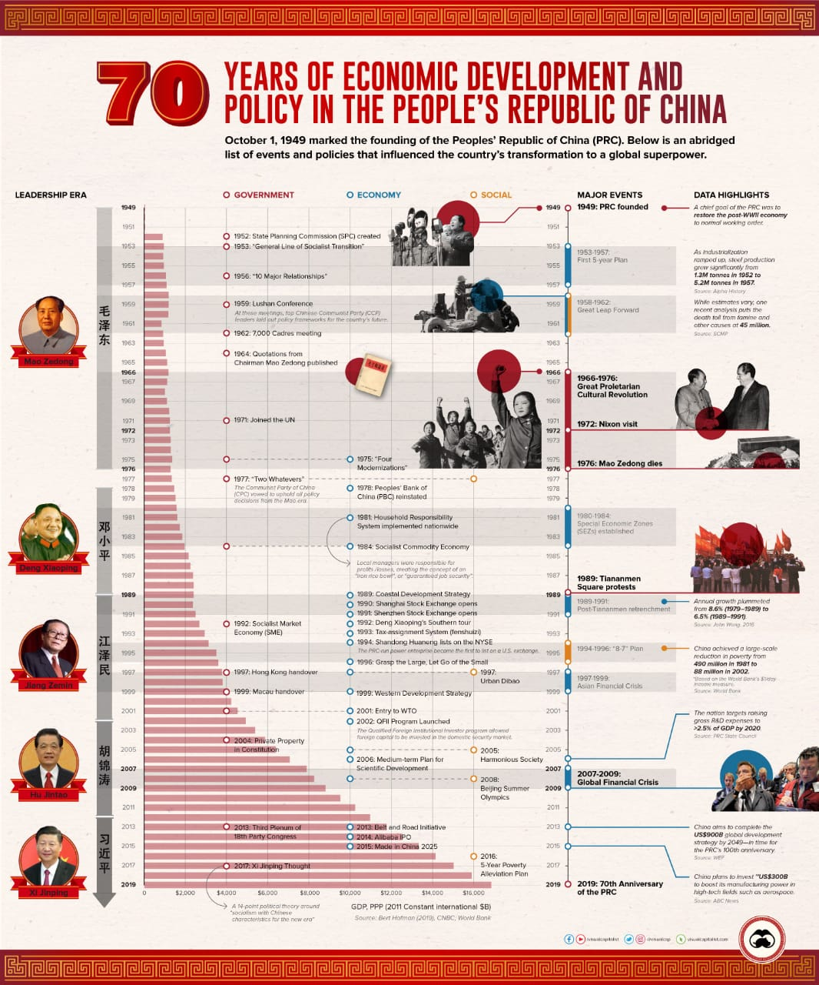

Slide 54
THANK YOU

